Slide 1

Presenting MSE Results with Slick
Global Blue Shark MSE Workshop
14 – 16 October 2025
Rome, Italy
Adrian Hordyk
www.bluematterscience.com

Slide 2
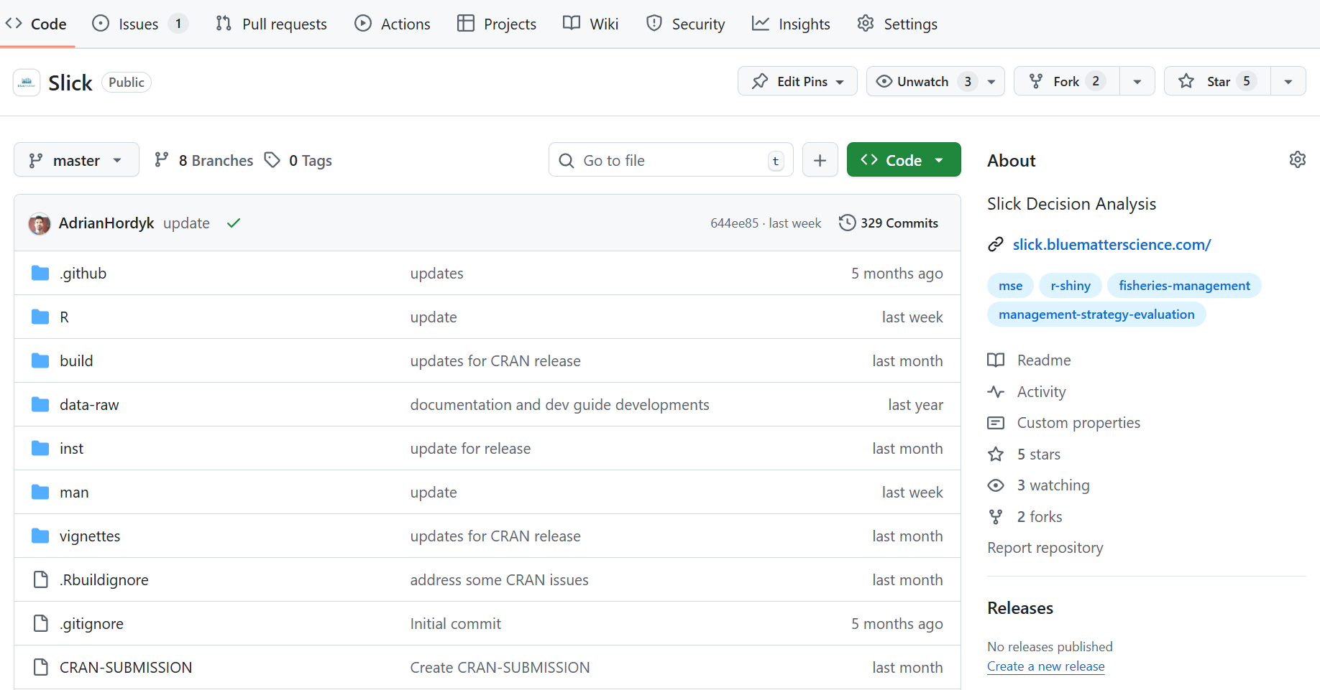
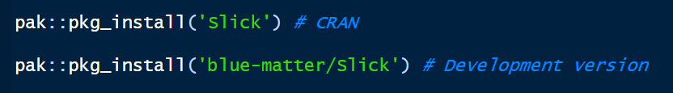
Slick: Interactive Visualization of MSE Results
Overview
R package designed for visualizing and exploring MSE results
Flexible functions for producing publication quality figures and tables
R Shiny App for interactive exploration of results
Under continued development – collaboration welcome!
Code on GitHub: https://github.com/Blue-Matter/Slick
Version 1.0 available on CRAN
Help Documentation and Development Guide

Slide 3
Slick: Interactive Visualization of MSE Results
Overview
R package designed for visualizing and exploring MSE results
Flexible functions for producing publication quality figures and tables
R Shiny App for interactive exploration of results
Under continued development – collaboration welcome!
Code on GitHub: https://github.com/Blue-Matter/Slick
Version 1.0 available on CRAN
Help Documentation and Development Guide
Limitations:
May not be suitable for all applications, e.g., multiple stocks, spatial performance metrics

Slide 4
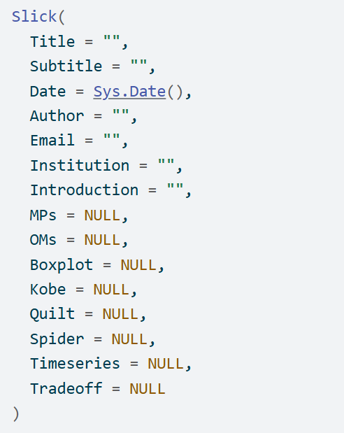
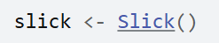
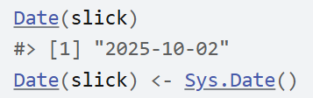
Slick Object
Slick Class Object
Create `Slick` class object
Access and assign slots with functions

Slide 5
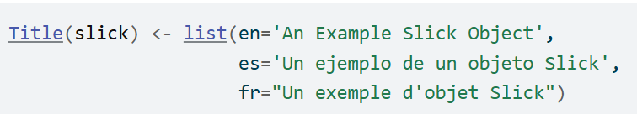
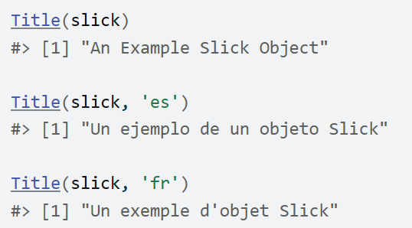
Multi-Language Support

Slide 6
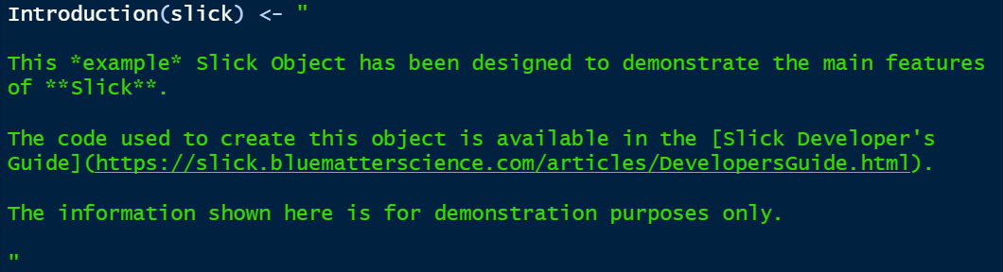
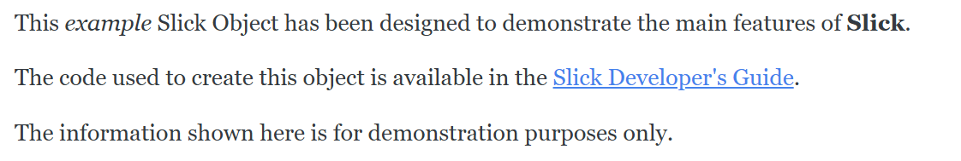
Markdown Support
Markdown:
How it will appear in the App:

Slide 7
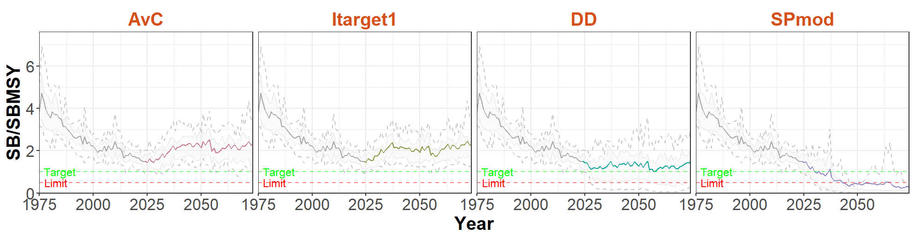
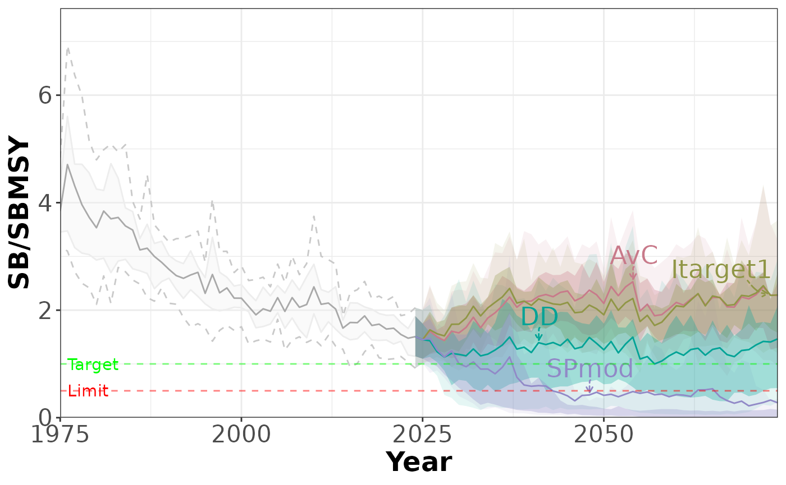
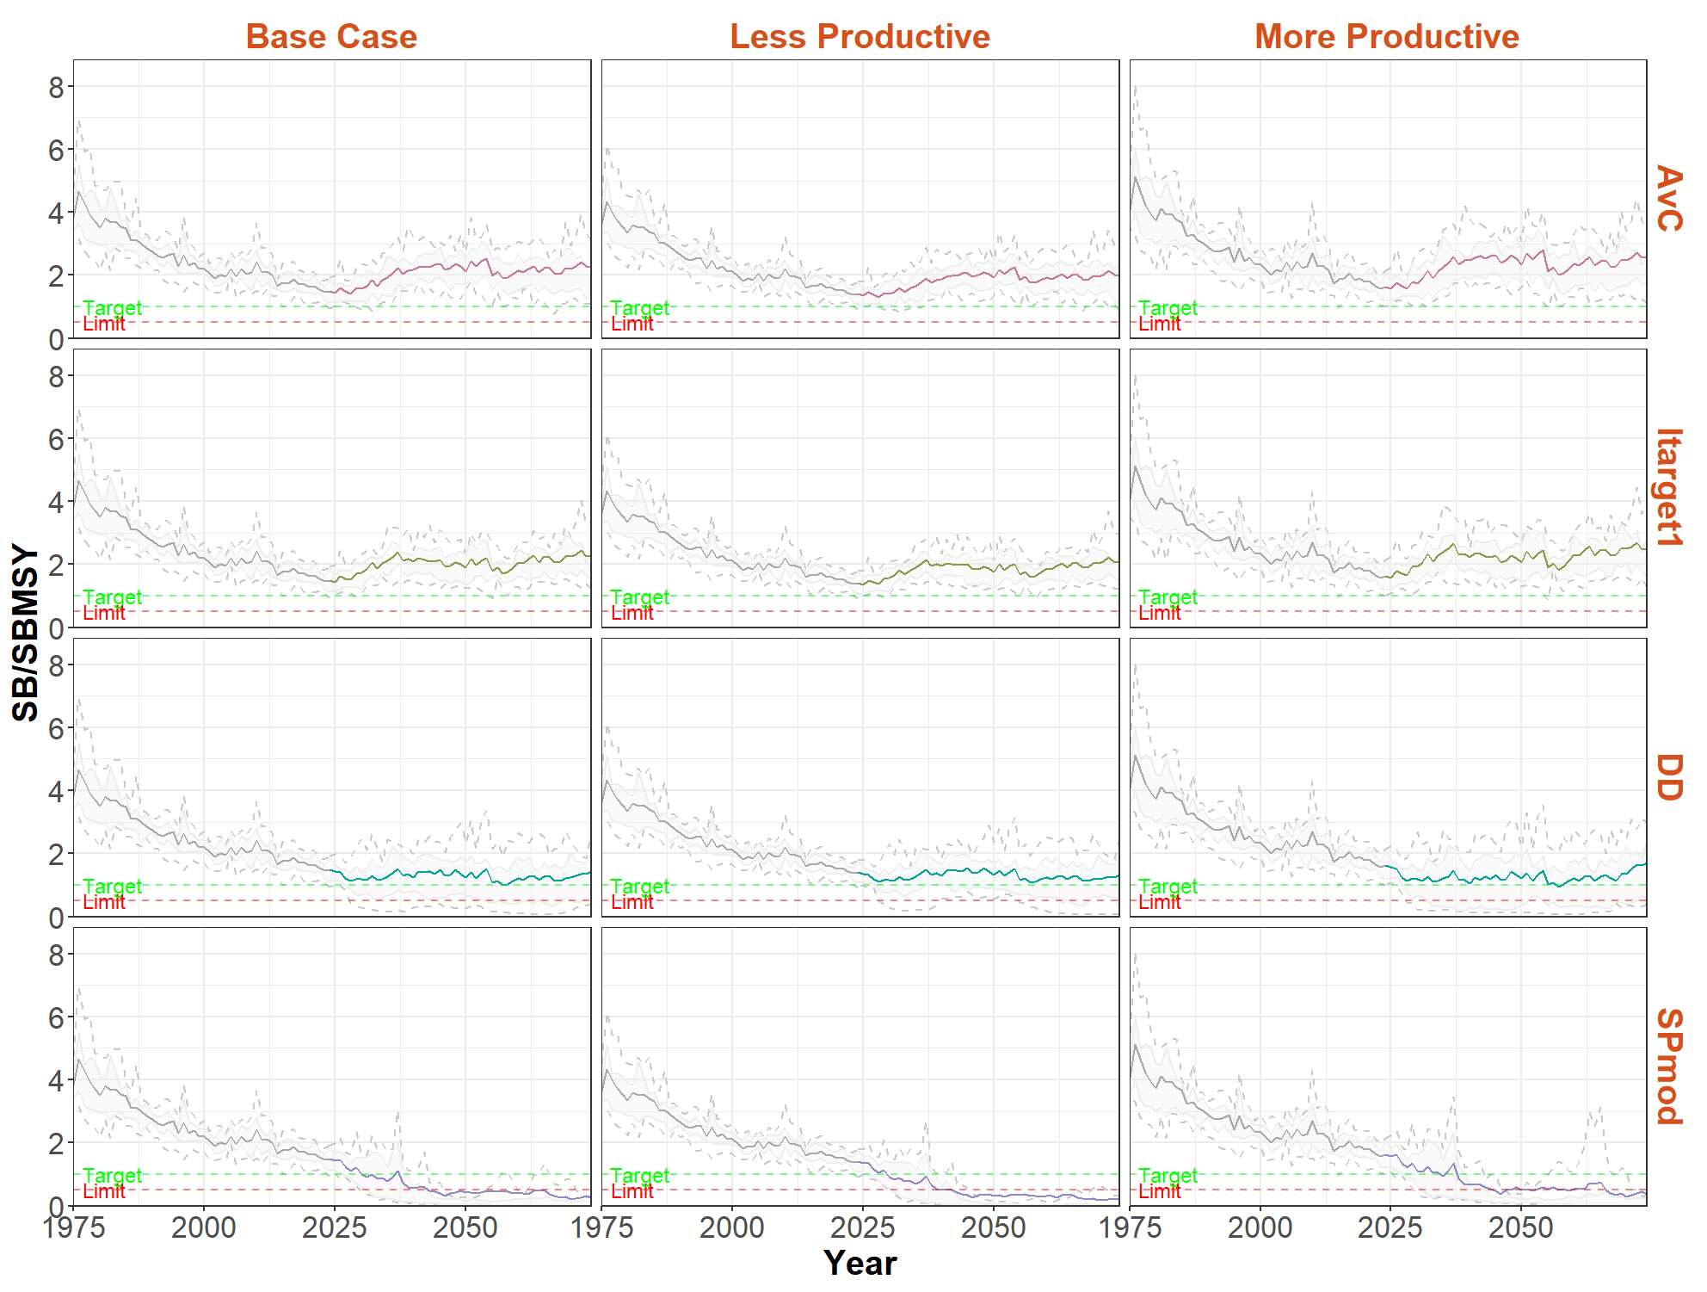
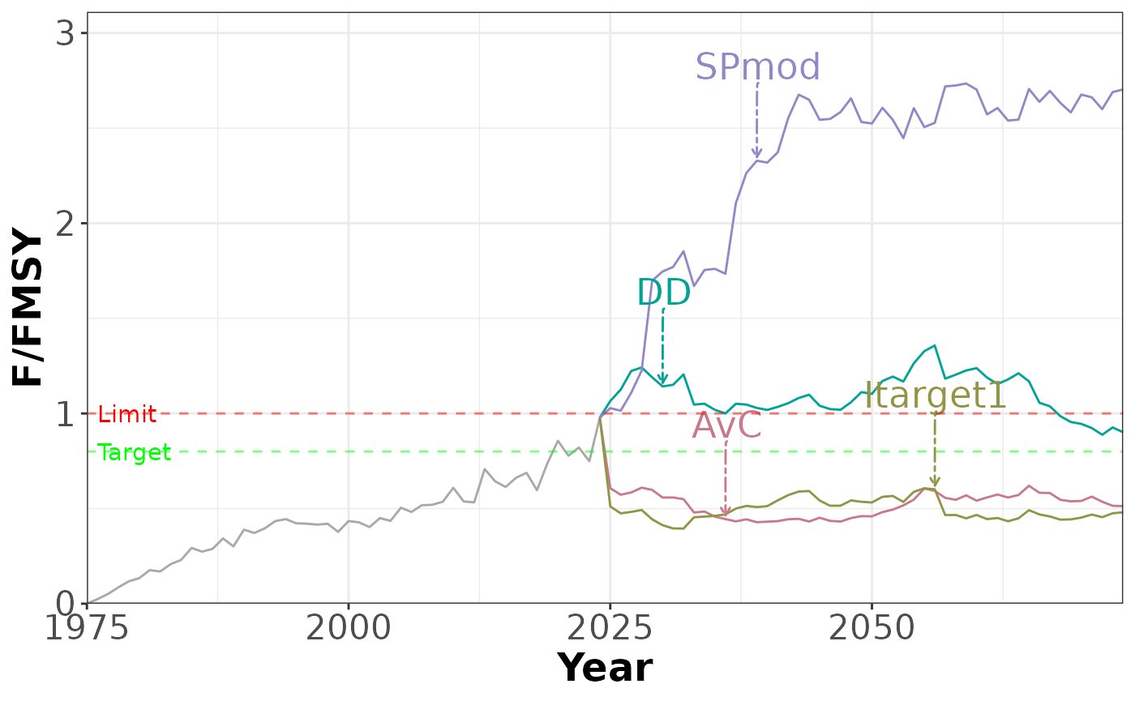
Plots: Time Series

Slide 8
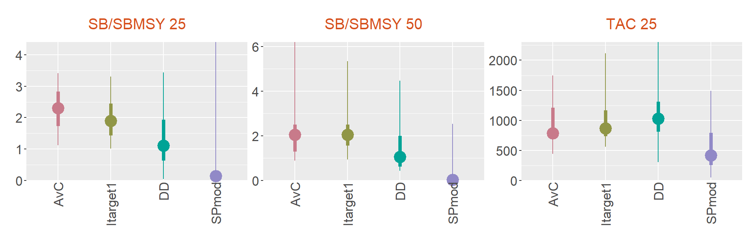
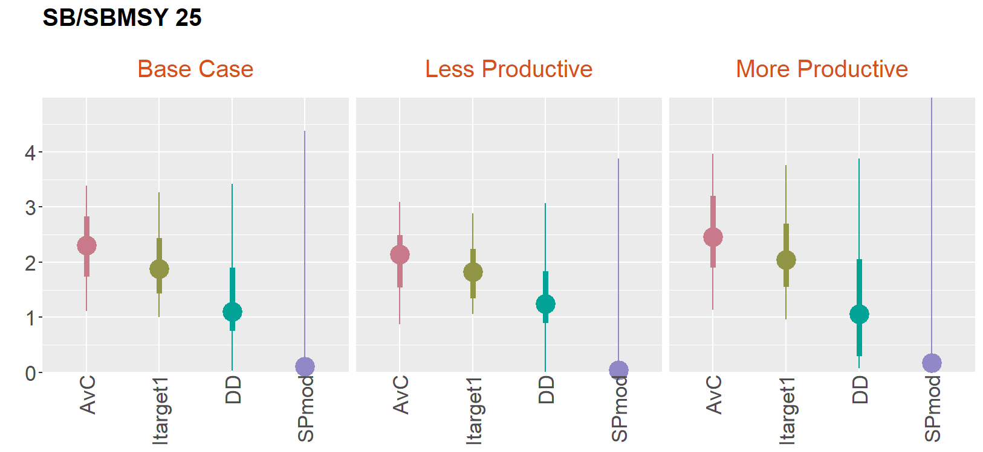
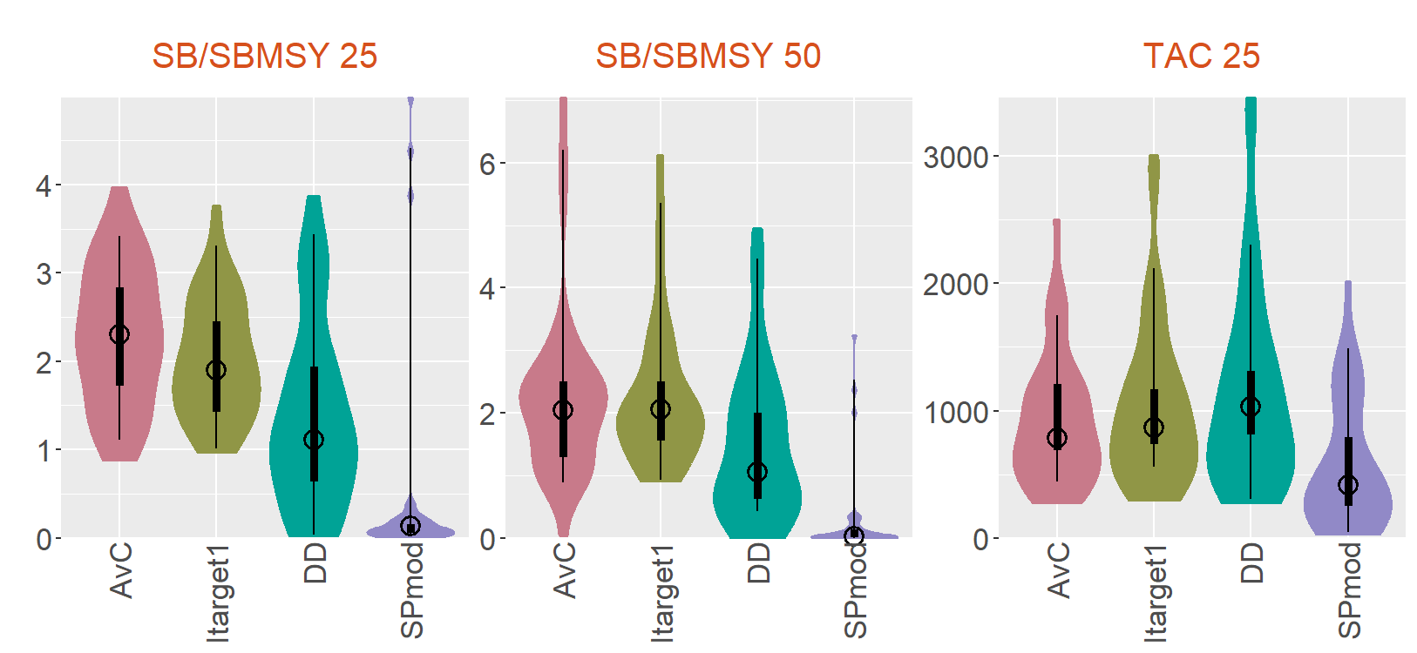
Plots: Boxplot

Slide 9
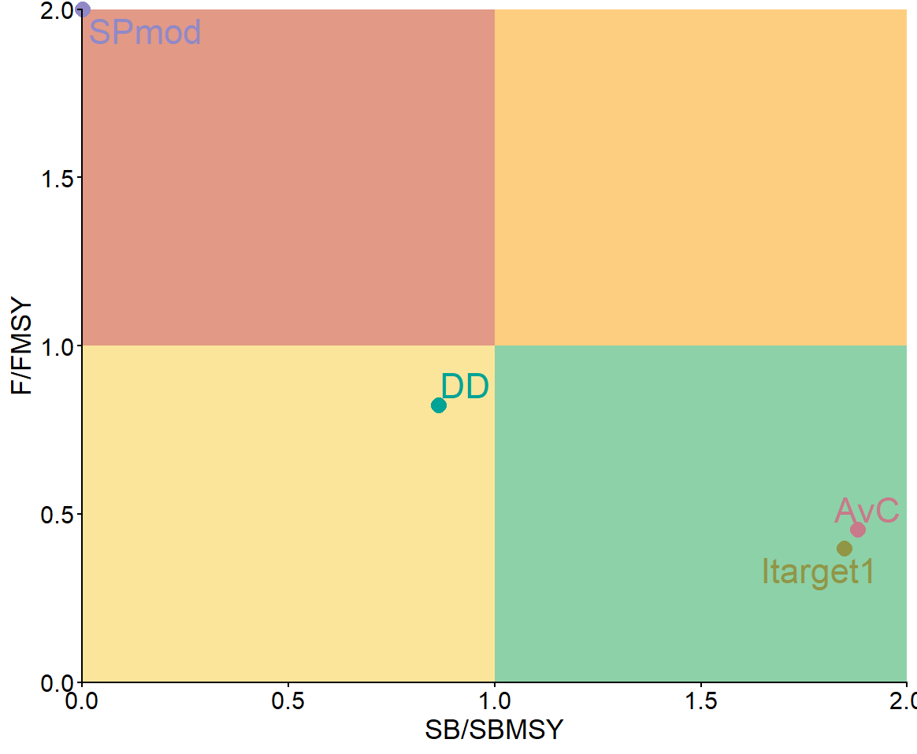
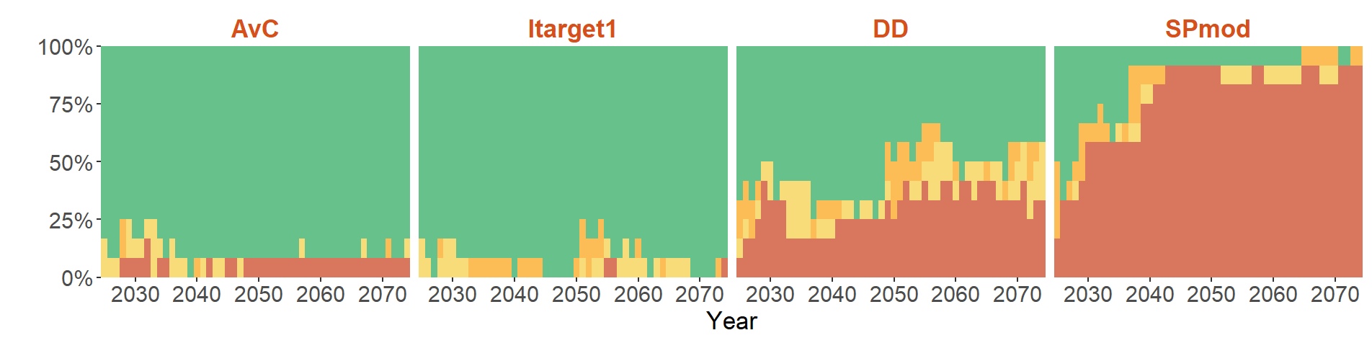
Plots: Kobe

Slide 10
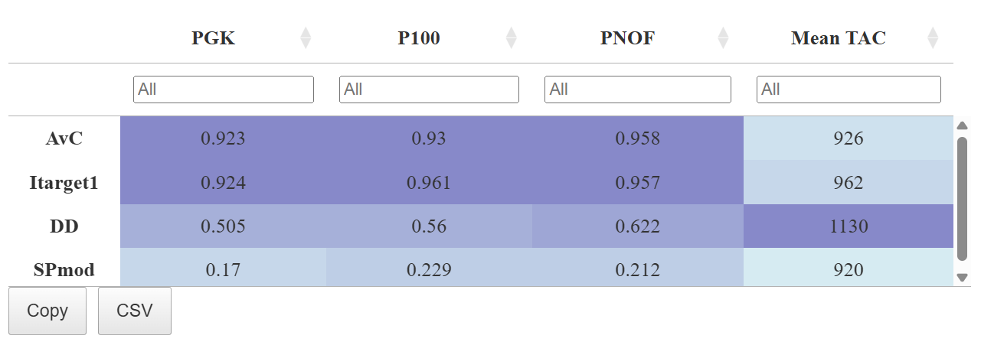
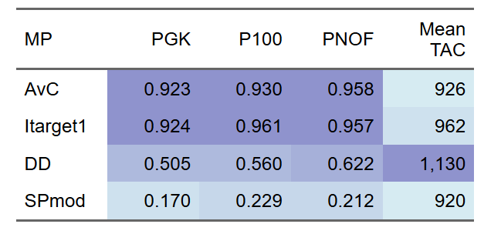
Plots: Quilt
HTML Table: search, order, filter
Static Table for PDF & Word docs

Slide 11
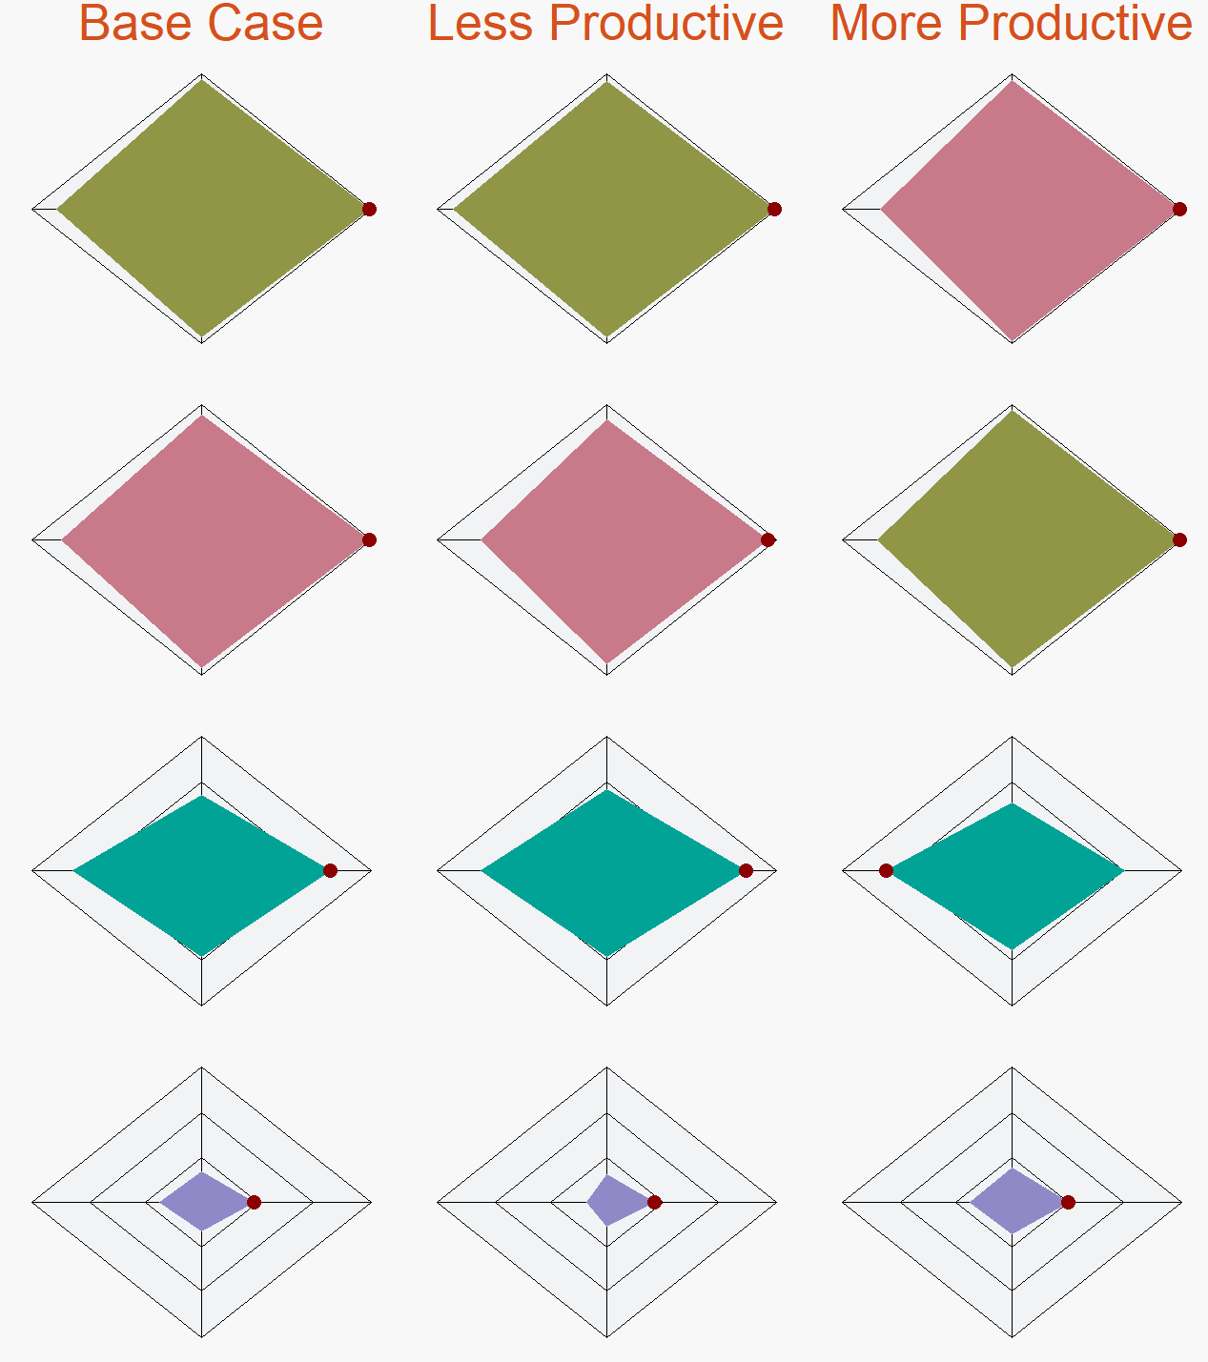
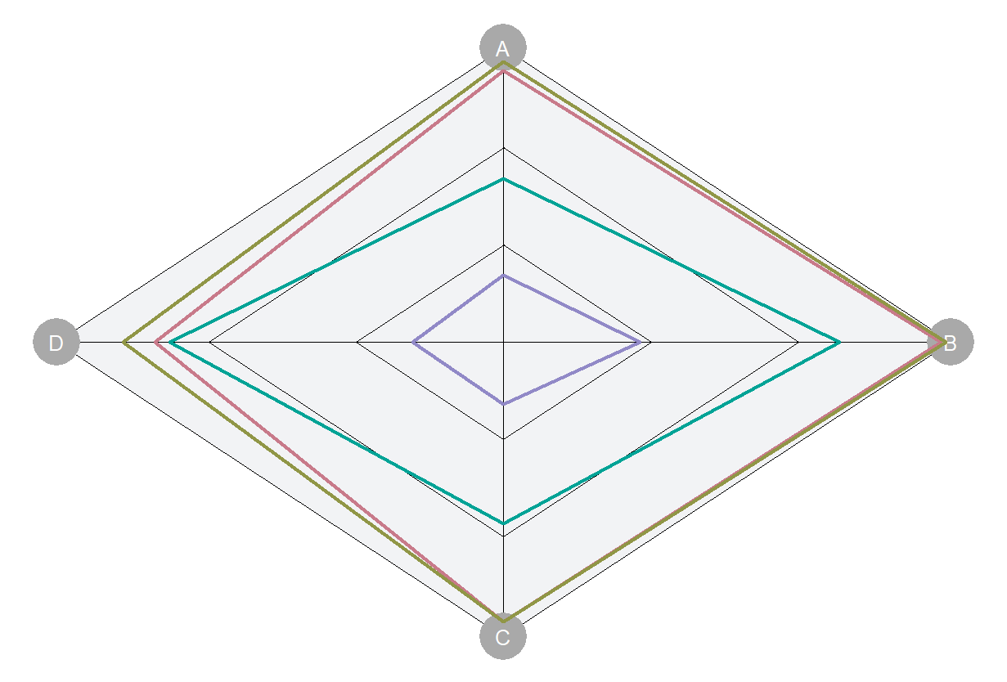
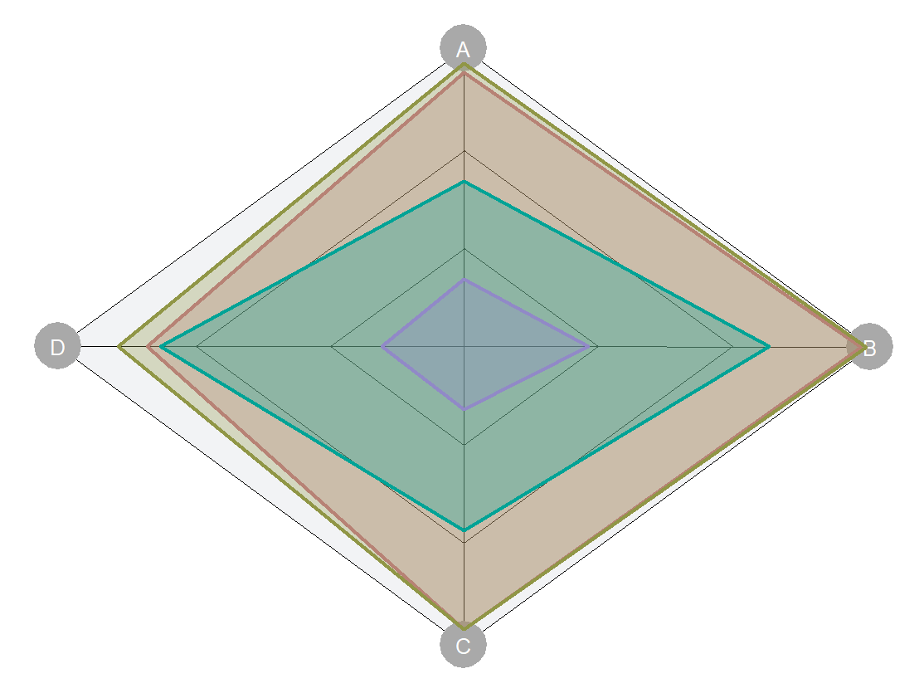
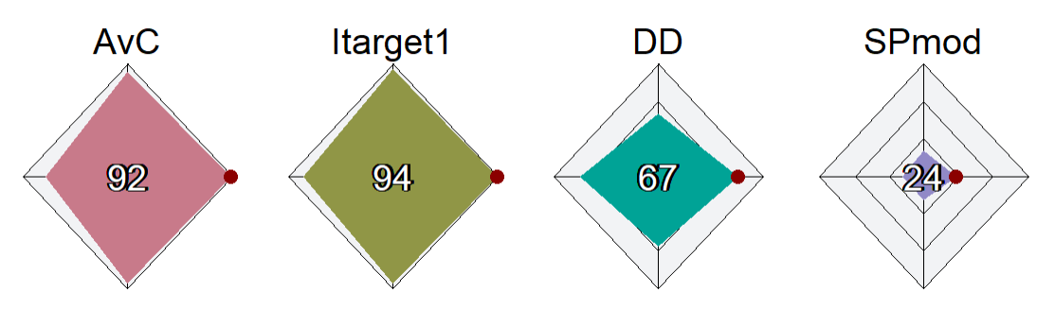
Plots: Spider

Slide 12
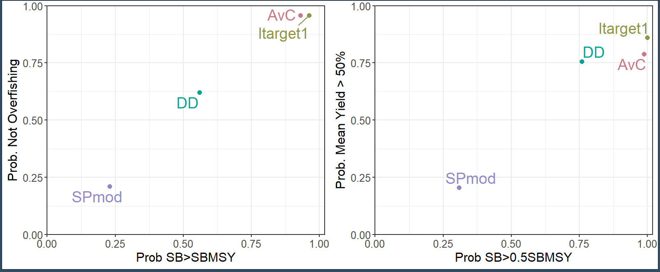
Plots: Trade-Off

Slide 13
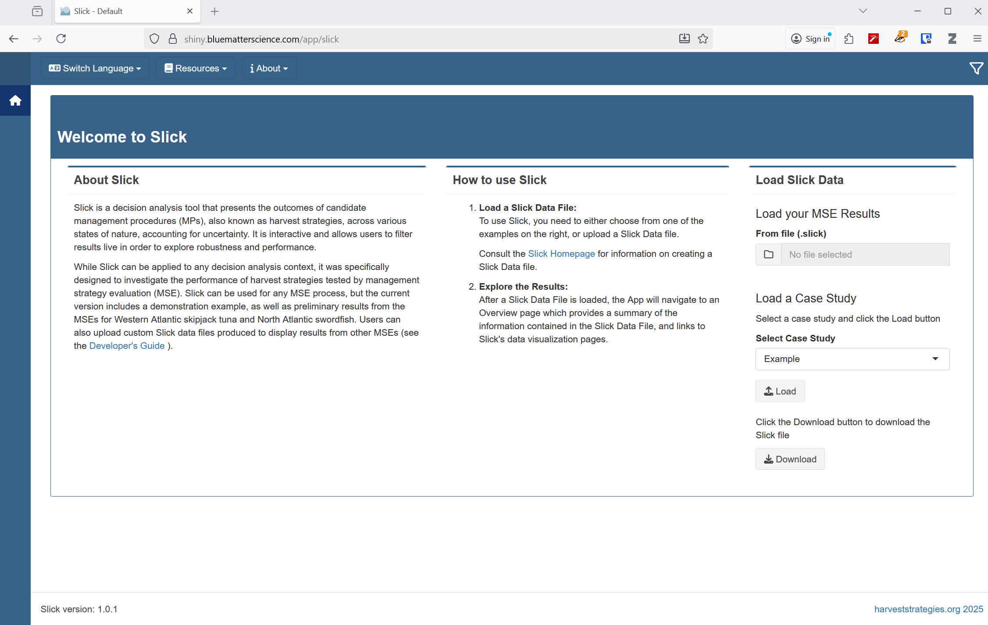
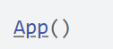
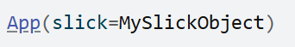
Shiny App
Online App
https://shiny.bluematterscience.com/app/slick
Run App locally
Load Slick object directly from console

Slide 14
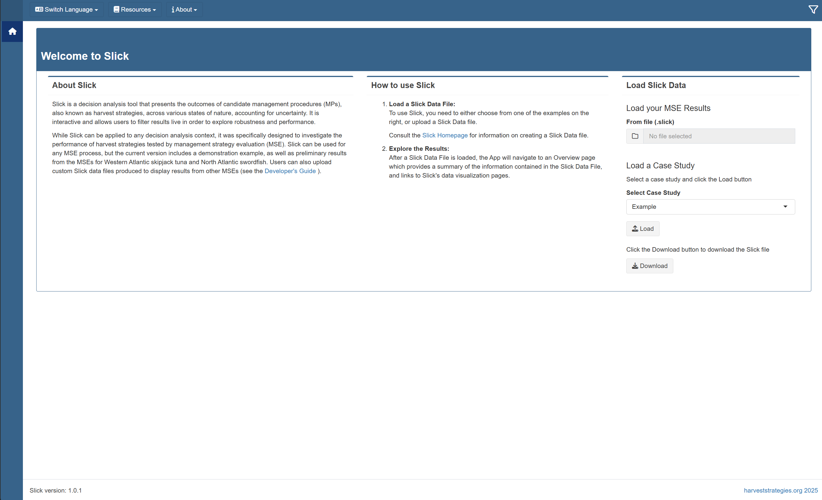

Slide 15
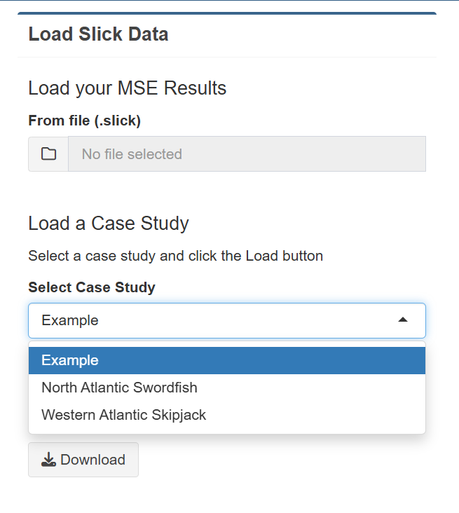
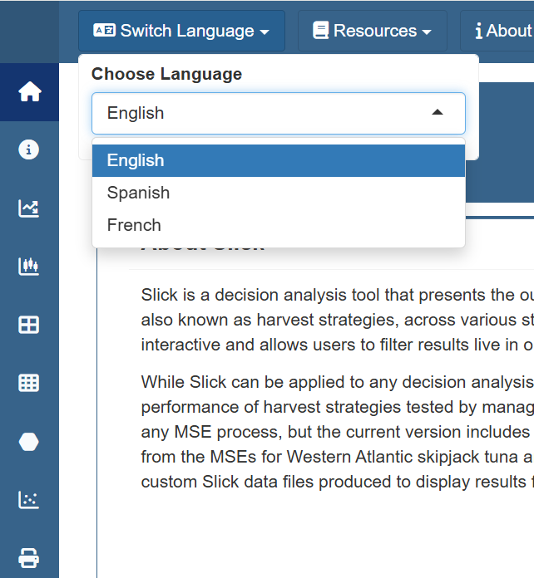
Load Slick Objects and Choose Language

Slide 16
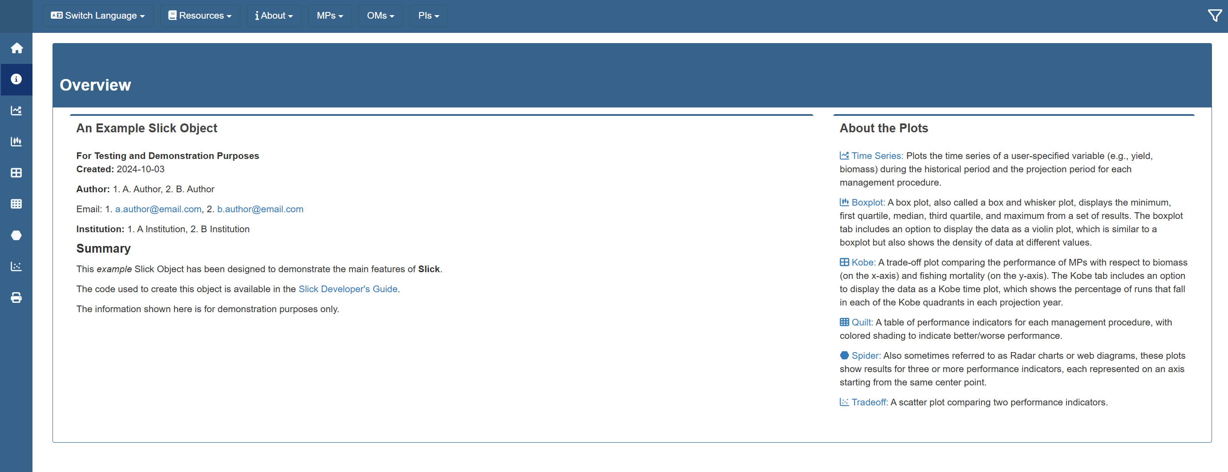
Title, Authors, and Introduction

Slide 17
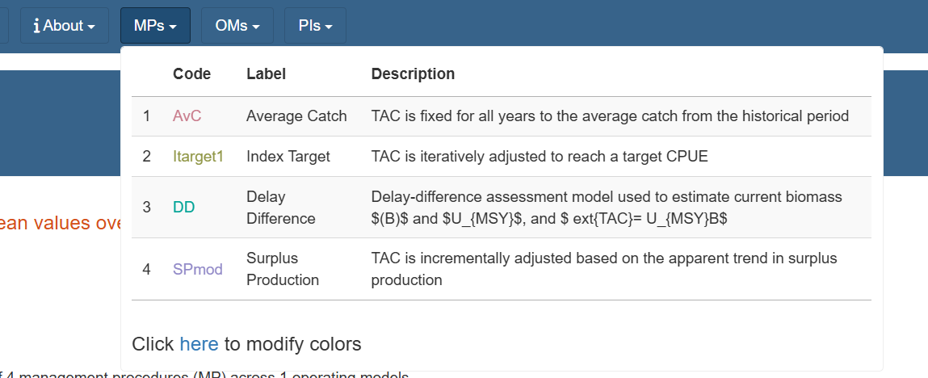
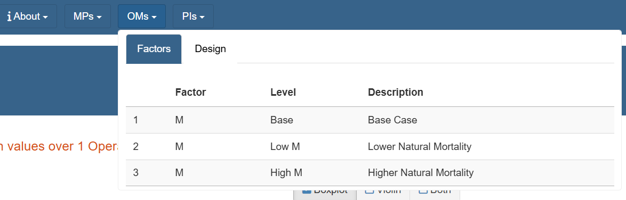
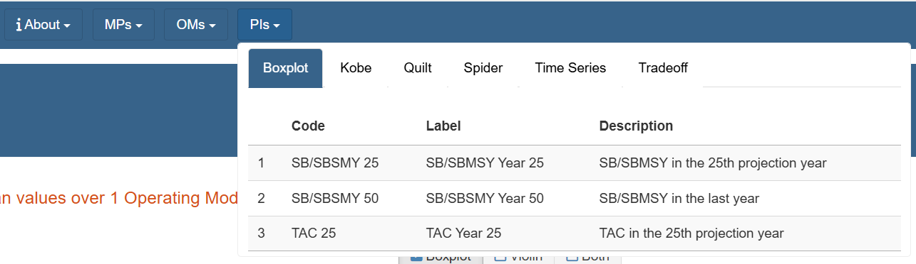
Descriptions of MPs, OMs, and PIs

Slide 18
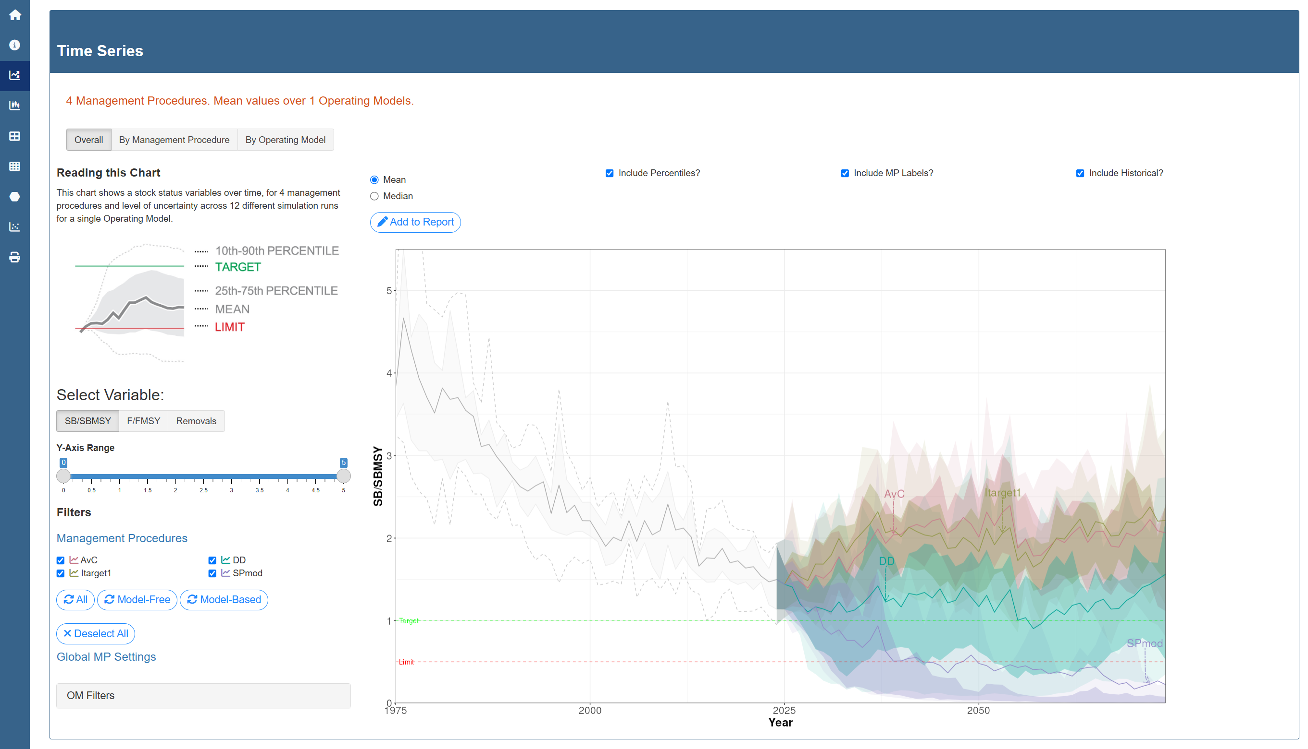
Example Plot Page: Time Series

Slide 19
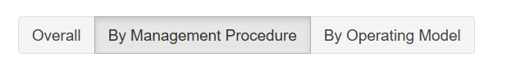
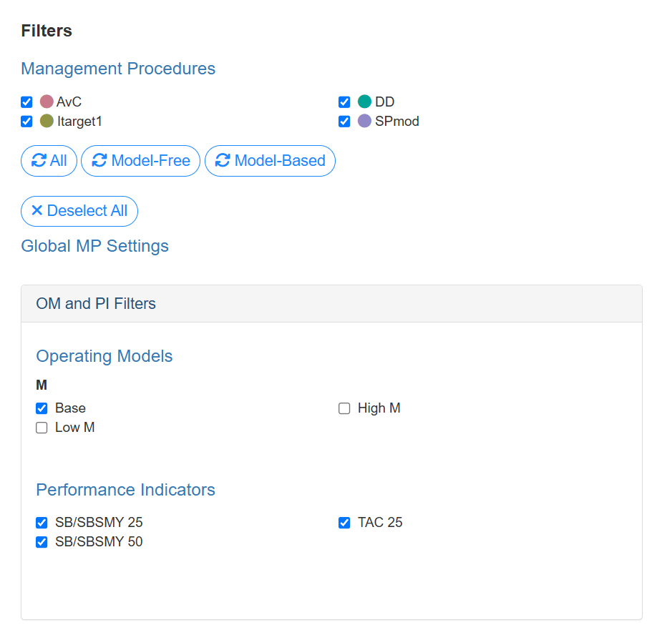
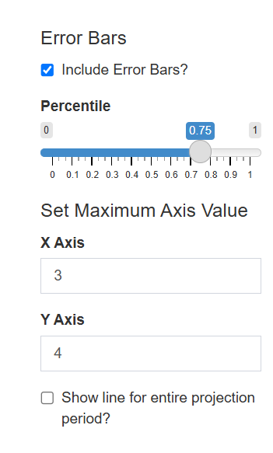
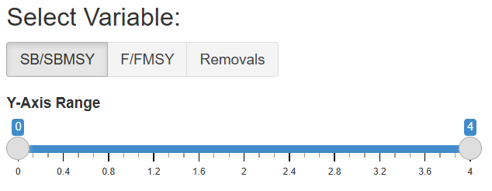
Filters and Controls
Plot Controls
Select MPs
Preset Buttons
Filter OMs and PIs

Slide 20
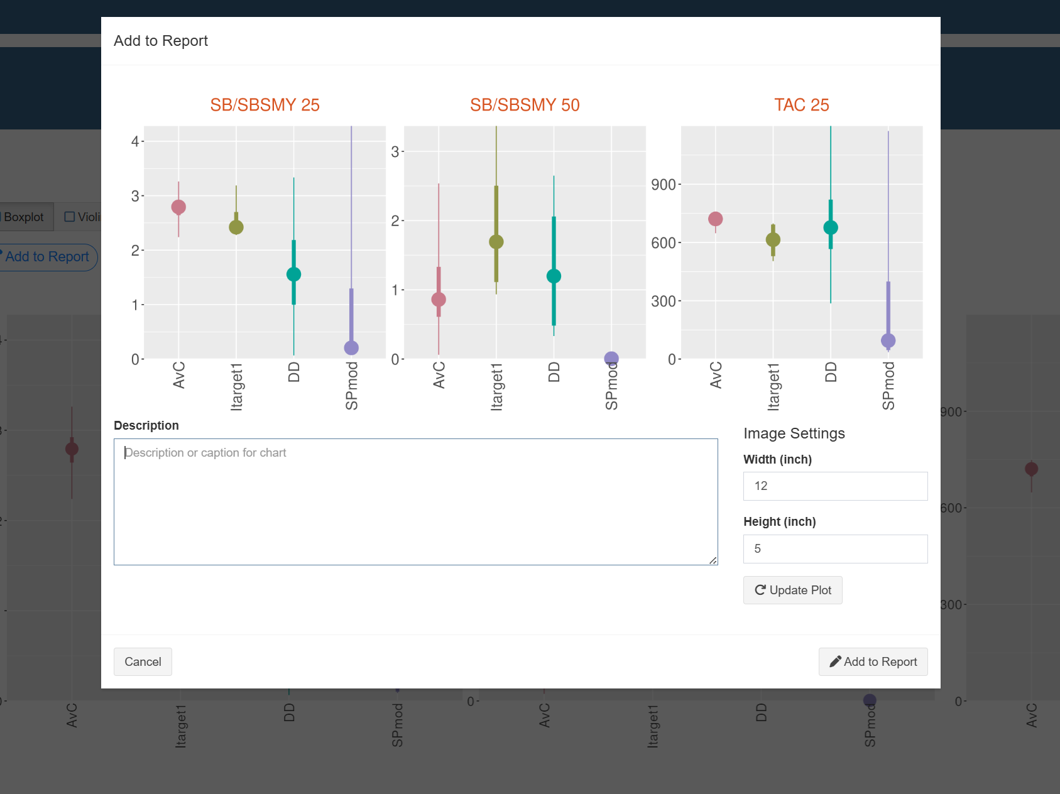
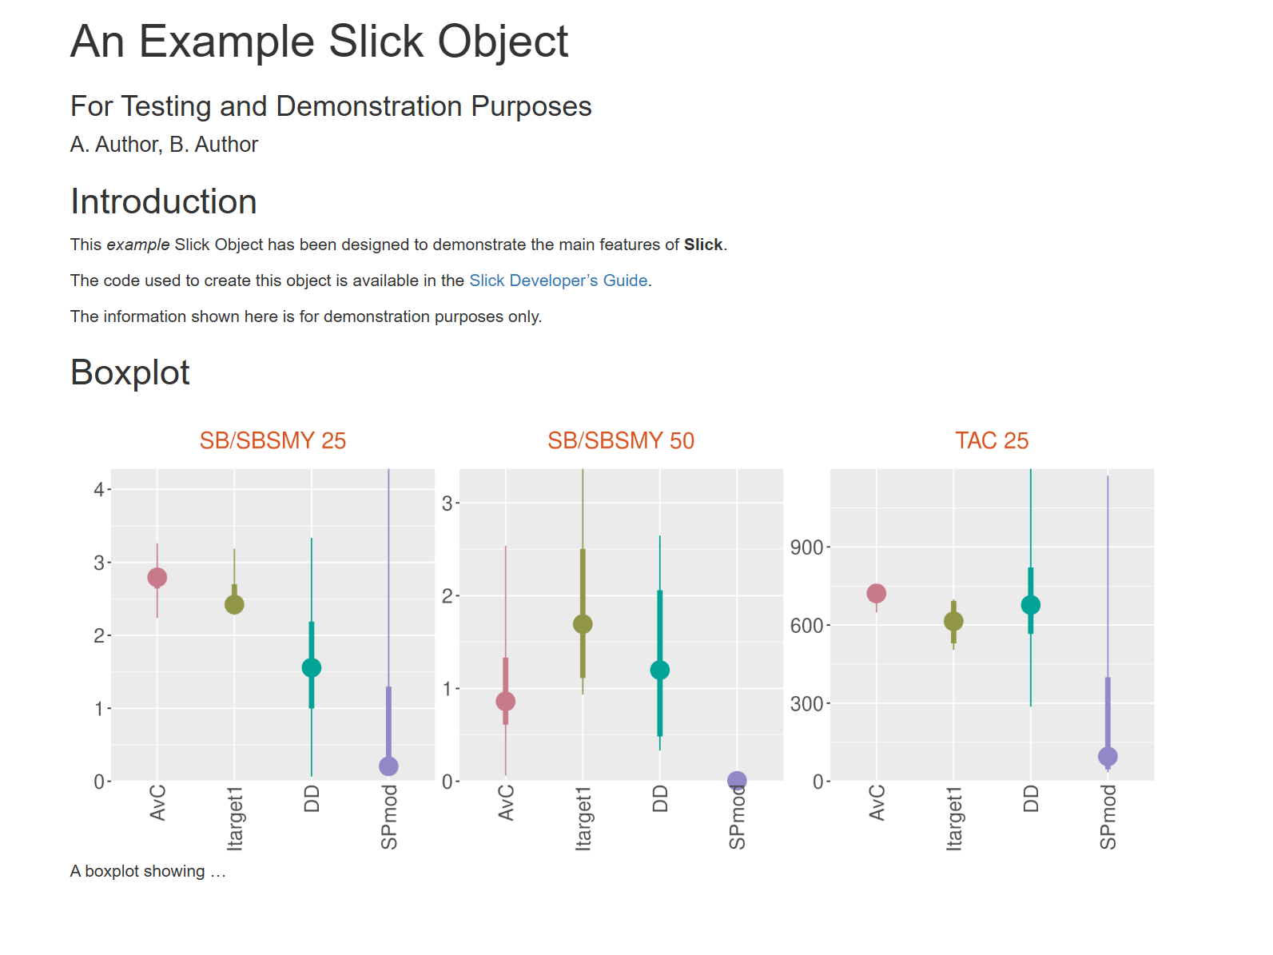
Report
Compile report to HTML or Word
Add plots and captions to Report

Slide 21
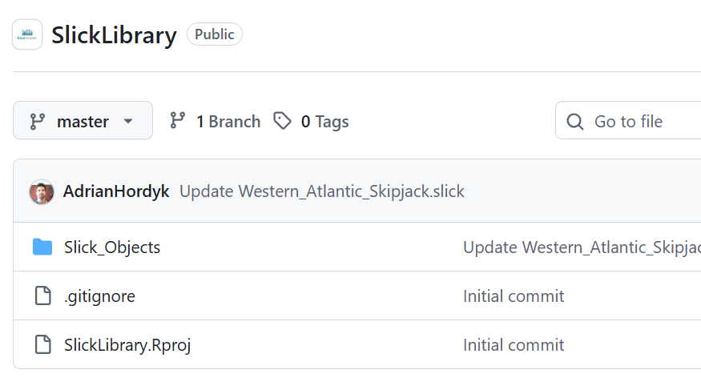
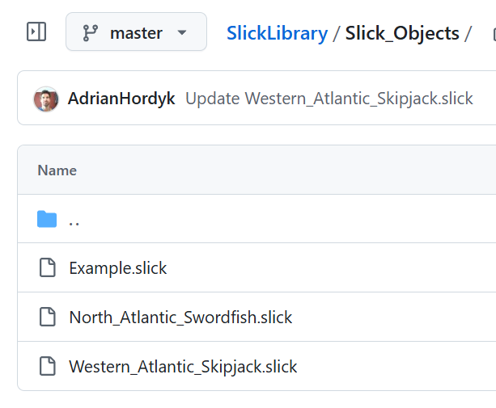
Slick Object Library
Make your Slick object accessible to online users
https://github.com/Blue-Matter/SlickLibrary

Slide 22
Slick Breakout Session
Build Slick object with Blue Shark MSE results
Explore plots in console and app
Populate Reporting ppt with key results

Slide 23
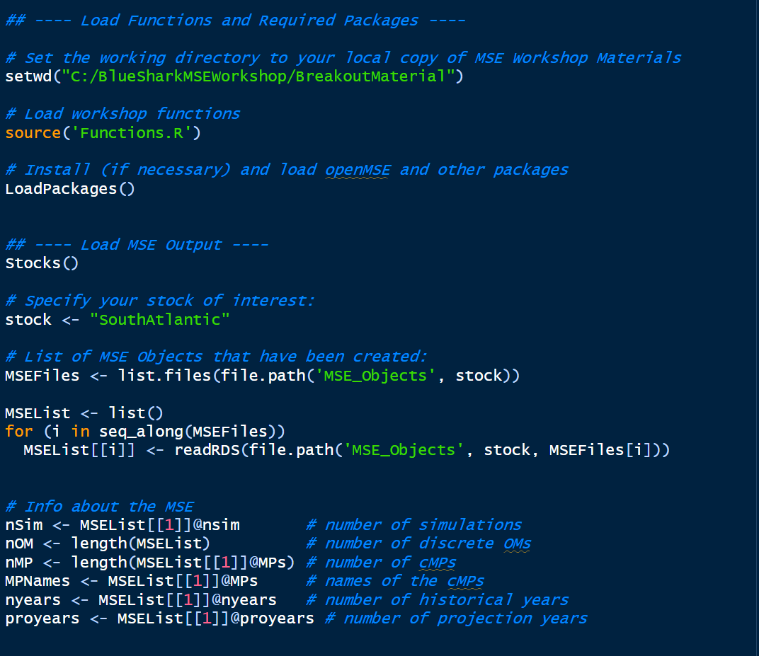
Setup
Set working directory to local copy
Load R packages 🤞
Choose your stock
Import MSE objects produced yesterday
Information about MSE used to set up Slick object

Slide 24
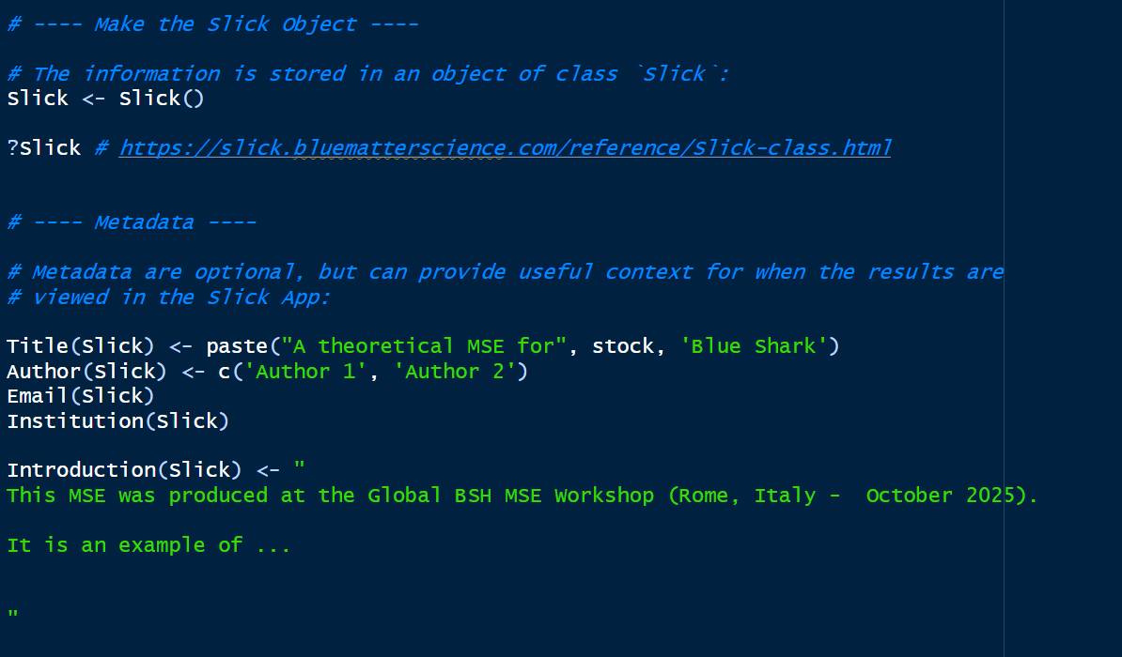
Create Slick Object
Create `Slick` class object
Add title and other info to appear in the App

Slide 25
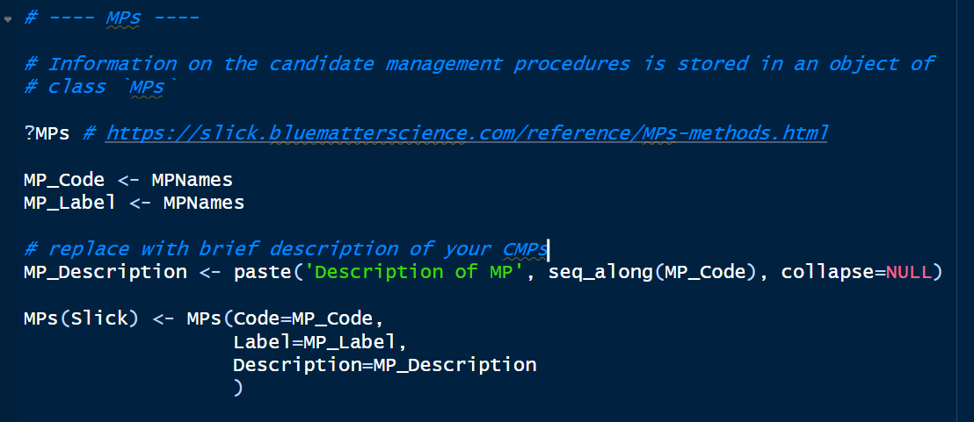
Populate MP information

Slide 26
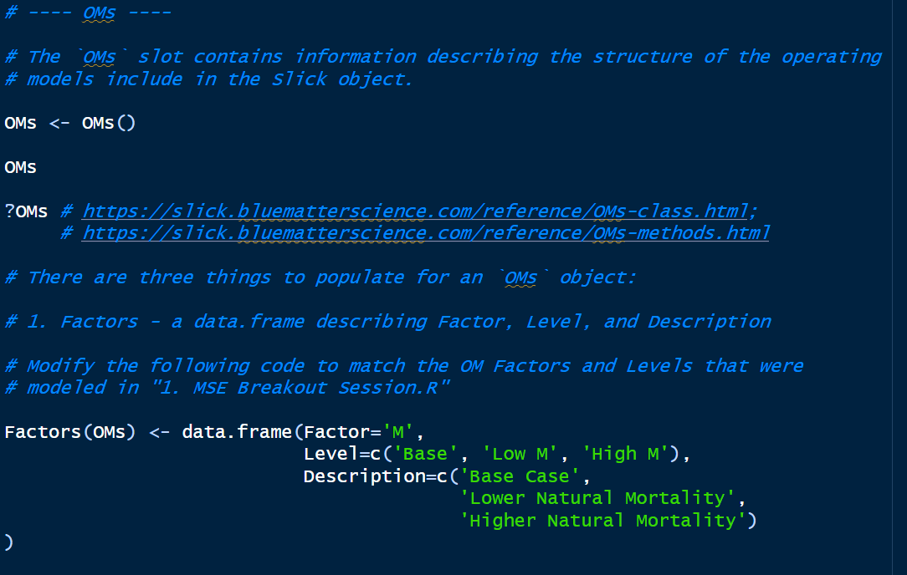
Populate OM information

Slide 27
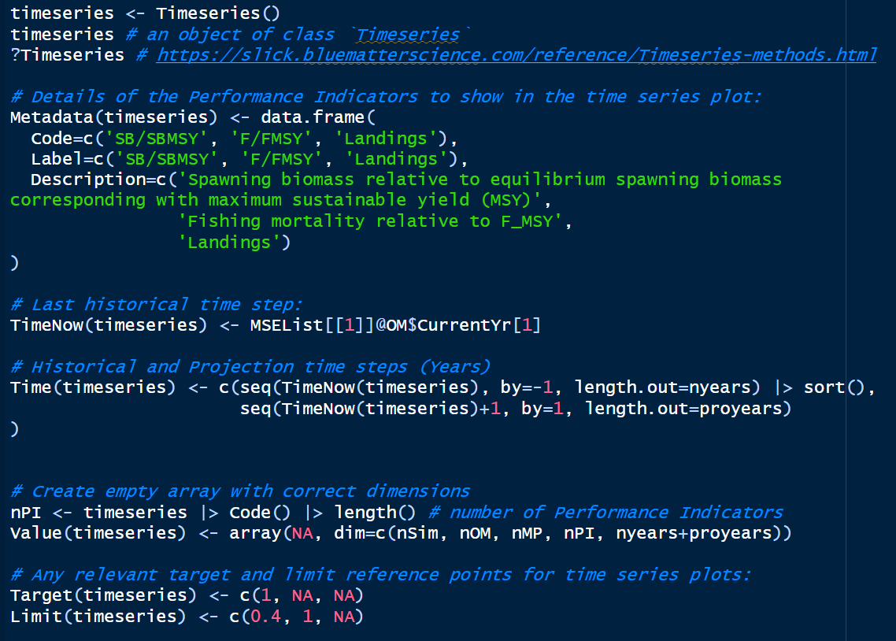
Populate Time Series Plot

Slide 28
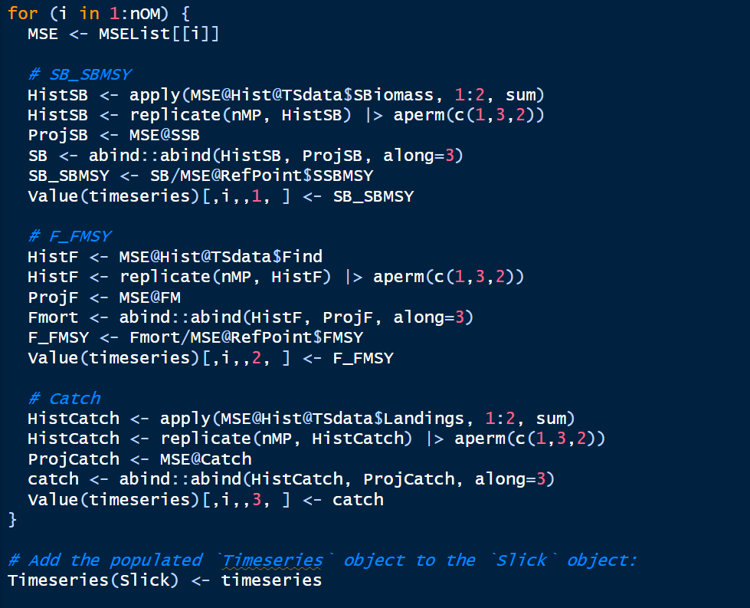
Populate Time Series Plot cont.

Slide 29


Plot Time Series
Show results for OM 1 (and PI 1)

Slide 30


Plot Time Series
Show results for PI 3 (averaged over all OMs)

Slide 31

Kobe Plot

Slide 32




Kobe Plot

Slide 33

Quilt Plot

Slide 34

Other plots, Save, and App
Boxplot
Spider
Trade-Off
Save `Slick` object to disk
Run App locally

Slide 35

Reporting

